Slide 1
Technical Writing: Flyers
Week 7, Chapter 7

Slide 2
What is a Flyer?
Can be as small as a postcard or as large as one, 8½ x 11 page
External correspondence sent to prospective or existing customers
Usually limited to one, very specific topic
Highlights how you or your company can meet a customer’s unique need

Slide 3
Key Points to Consider
1. Limit the Length of your Flyer to one page (8½ x 11).
2. Focus on one Specific Idea.
3. Include a Title at the top of your Flyer.
4. Limit your Text.
5. Increase your Font size.

Slide 4
Key Points to Consider Cont.
6. Use Graphics.
7. Use Color.
8. Use Highlighting techniques.
9. Find the “Phrase.”
10. Avoid Grammatical errors.

Slide 5
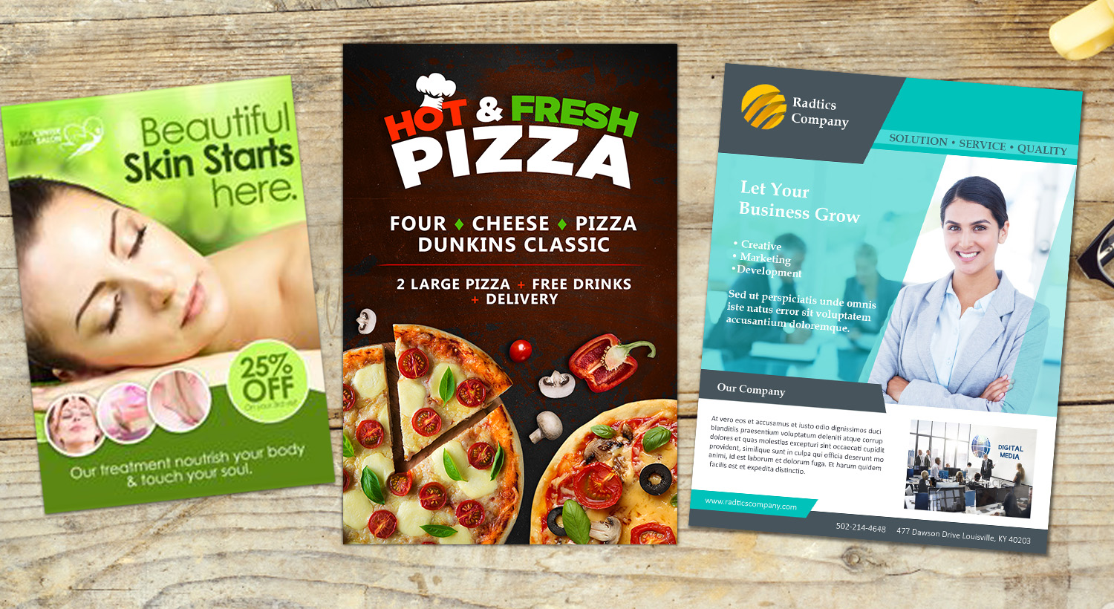
Example(s) of a Flyer

Slide 6


Example(s) of a Business Flyer

Slide 7
Activity: Flyers
Review any two business related flyers in groups of five
List the titles of the flyers your group reviewed
What are the main/specific ideas the flyers are focusing on?
What kind of graphics and colours have been used?
What is their(graphics and colours) importance?
What is the phrase?
And how does it serve its purpose?
(Activity time: 15 mins)

Slide 8
References
https://www.businessknowhow.com/marketing/flyer.htm
https://www.nextdayflyers.com/blog/effective-business-flyers/

